Slide 1


Bhavan's Vivekananda College of Science, Humanities & Commerce
TOPIC: SHAMPOO SALES DATASET
10: B.SREE VANI

Slide 2
Description
This dataset describes the monthly number of sales of shampoo over a 3 year period. The units are a sales count and there are 36 observations.
Objective
For shampoo sales, predict for next 12 months, Split to train/test and report MAPE and AIC

Slide 3

Data and Data Quality Check
Number of instances : 36 Number of Attributes : 2 (Months, Sales) Missing Attribute Values : None

Slide 4
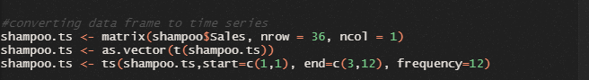
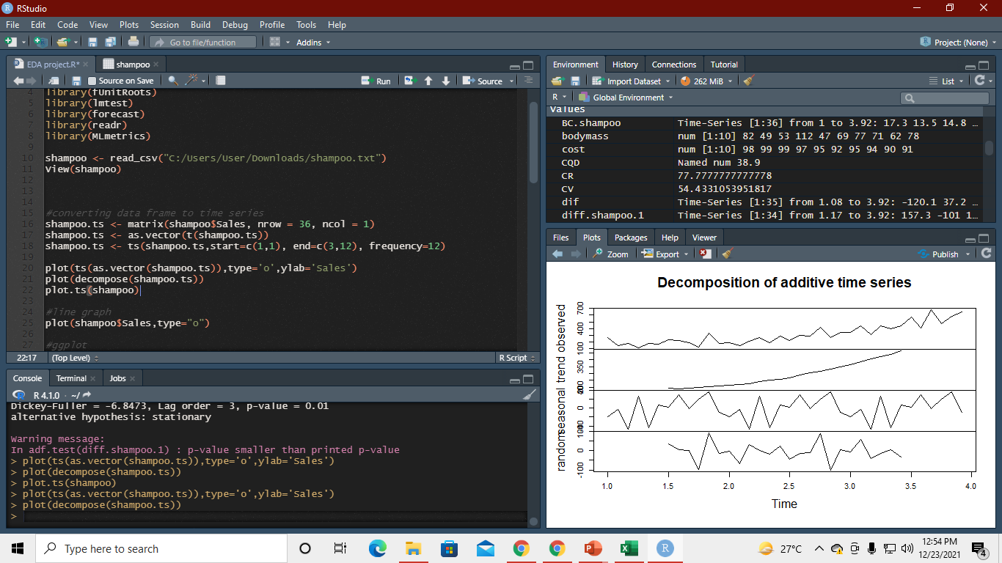
Converting data frame to time series
Decomposition Plot
plot(decompose(shampoo.ts)

Slide 5
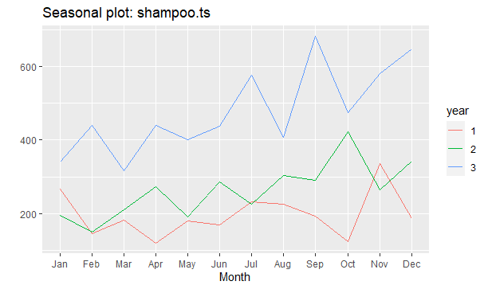
Seasonality Plot
ggseasonplot(shampoo.ts)

Slide 6
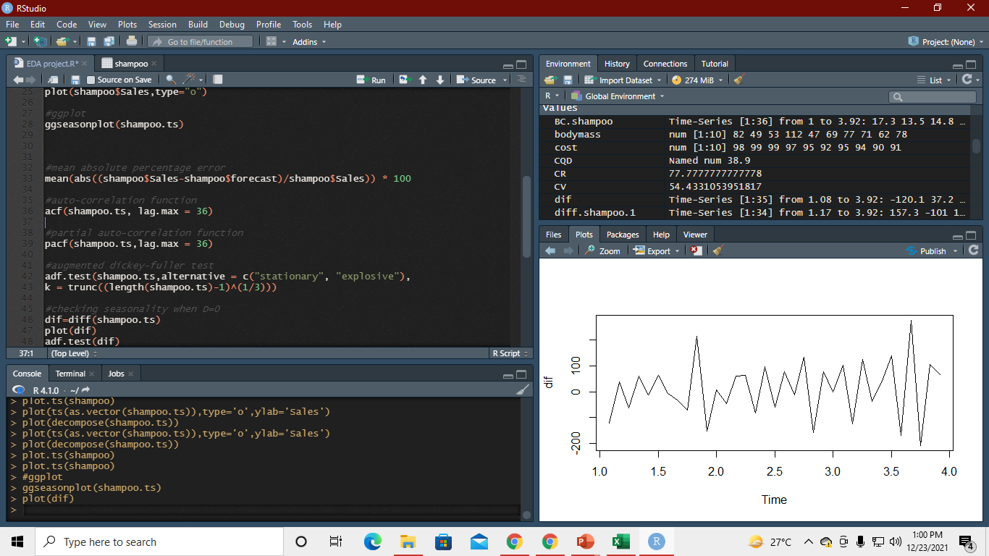
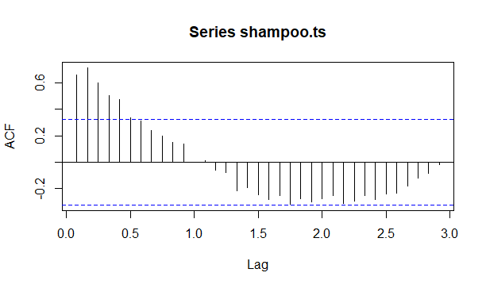
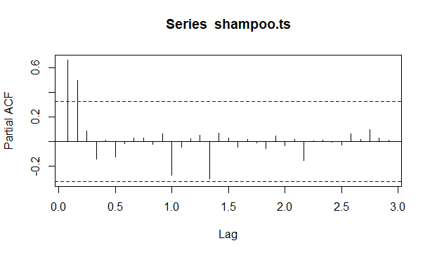
Auto correlation function and partial auto correlation function

Slide 7
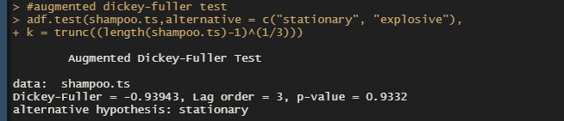
EDA Insights
Augmented dicky-fuller test(ADF) test for checking stationarity in the time series

Slide 8
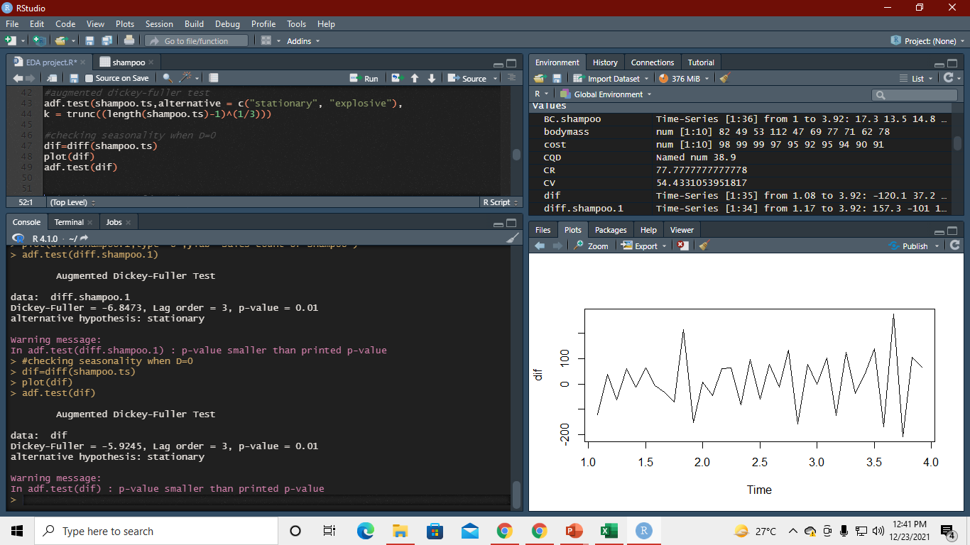
Difference in the time-series to check the seasonality
When D=0

Slide 9
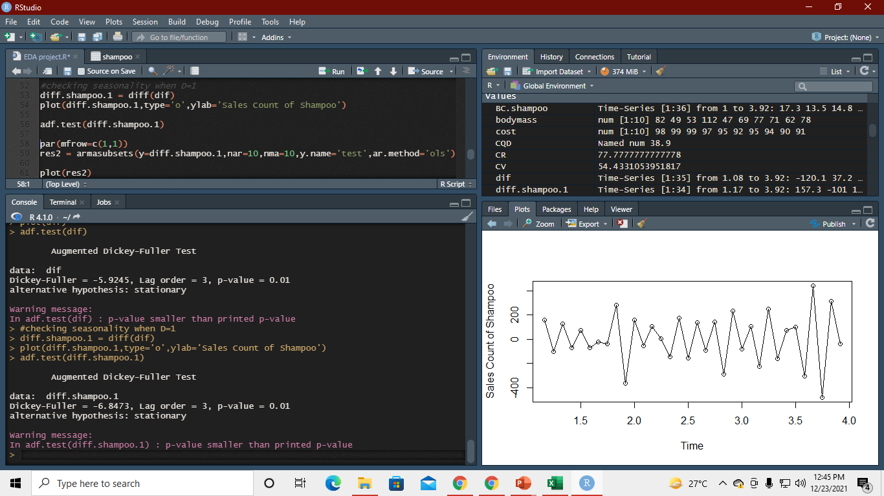
Difference in the time-series to check the seasonality
When D=1

Slide 10
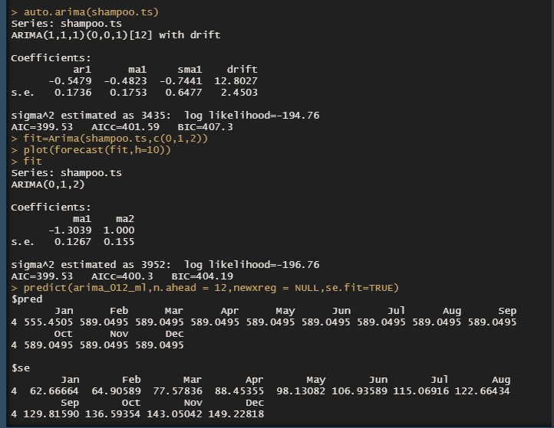
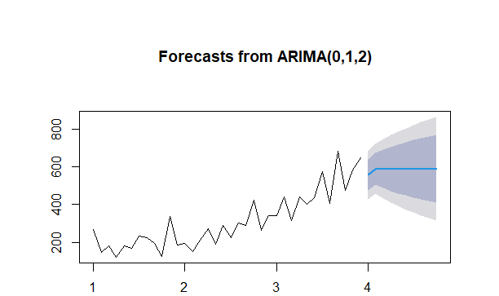
ARIMA and Prediction
We Predicated next 12 months Sales with using 36 months sales data
MAPE(Mean Absolute Percentage Error) = 0.24

Slide 11
THANK YOU

